Slide 1
Analysis of restaurant types for New York
Boletis Konstantinos March 2021

Slide 2
Project Description
New York is one of the most famous cities in the world. There are many people that are working on daily basis and thousands of visitors each day. So the restaurant business is very common and profitable. A very high percentage of restaurant investors are cooperating with real estate agents in order to find the perfect spot for their investment.

Slide 3
Problem Description
The problem is to create a smart map of New York that the real estate agent could distinguish the areas of interest according to the requirements of the client.

Slide 4
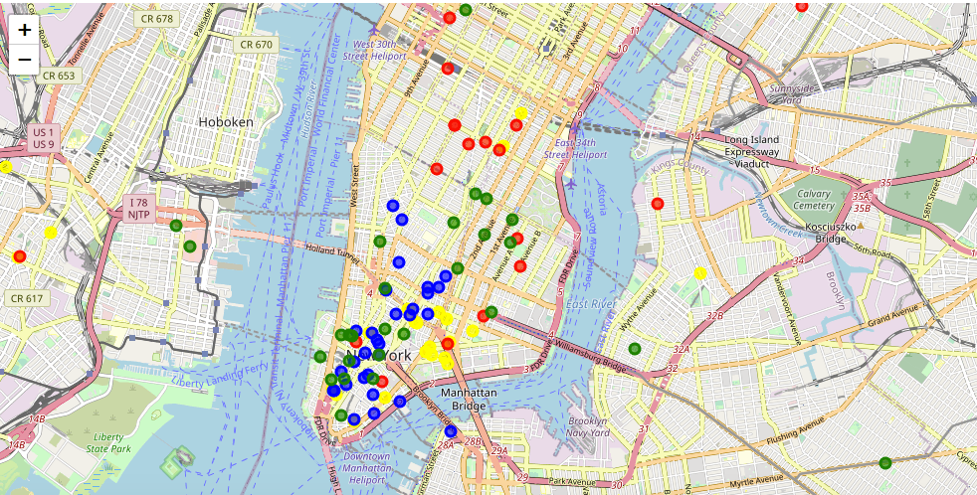
Deliverable: Map of New York

